Slide 1
Hypoxia-reporter construct: tumor progression
Gilkes-Macklin Collaboration
AMIGOS
September 20th 2017

Slide 2
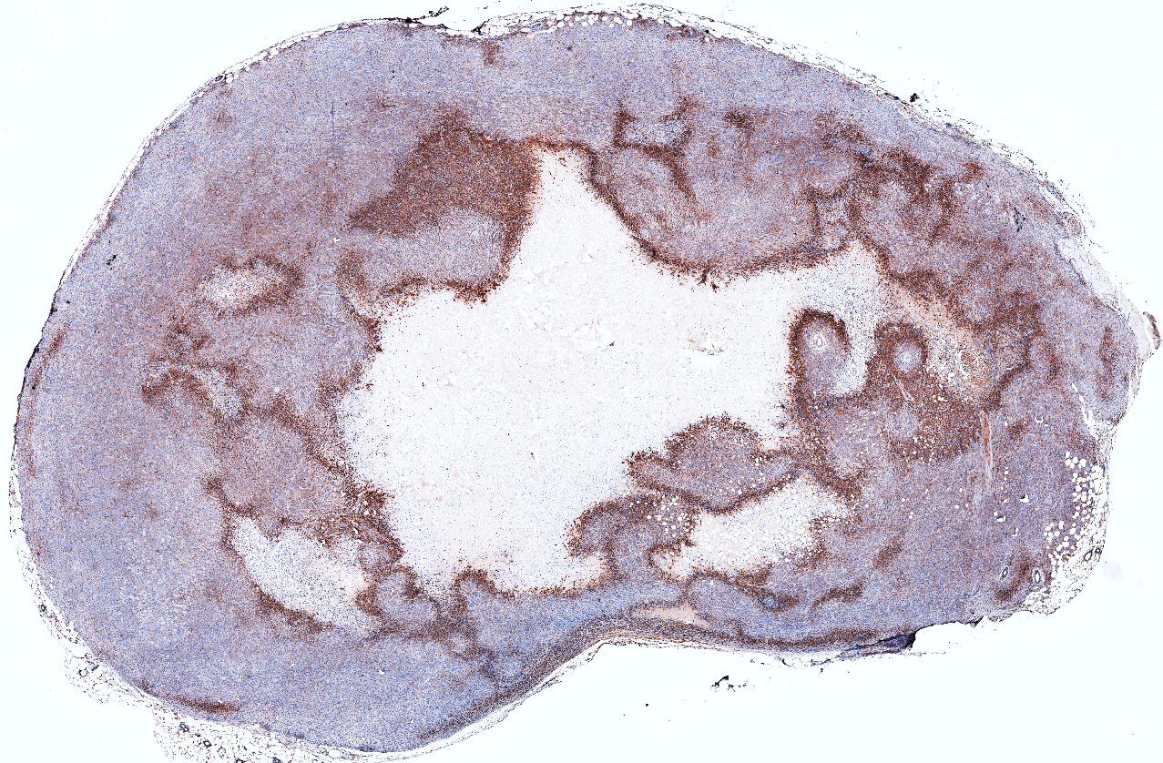

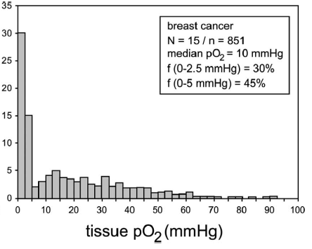
Tumor hypoxia
Necrosis
Hypoxyprobe

Slide 3
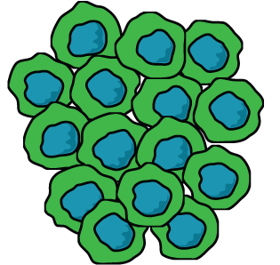
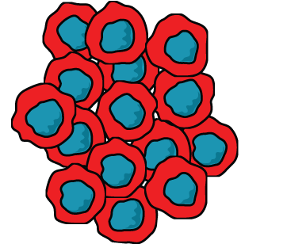
Hypoxia-reporter construct
System
CRE
STOP
STOP
STOP
STOP
CMV
loxp
GFP
loxp
GFP
CMV
loxp
GFP
CMV
loxp
DsRed
CRE
loxp
CRE
1% O₂
DsRed
HRE
HRE
CRE
HIF-ODD
HRE
HRE
HRE
CRE
HIF-ODD
HRE
HRE
HRE
Min TK promoter
Min TK promoter

Slide 4
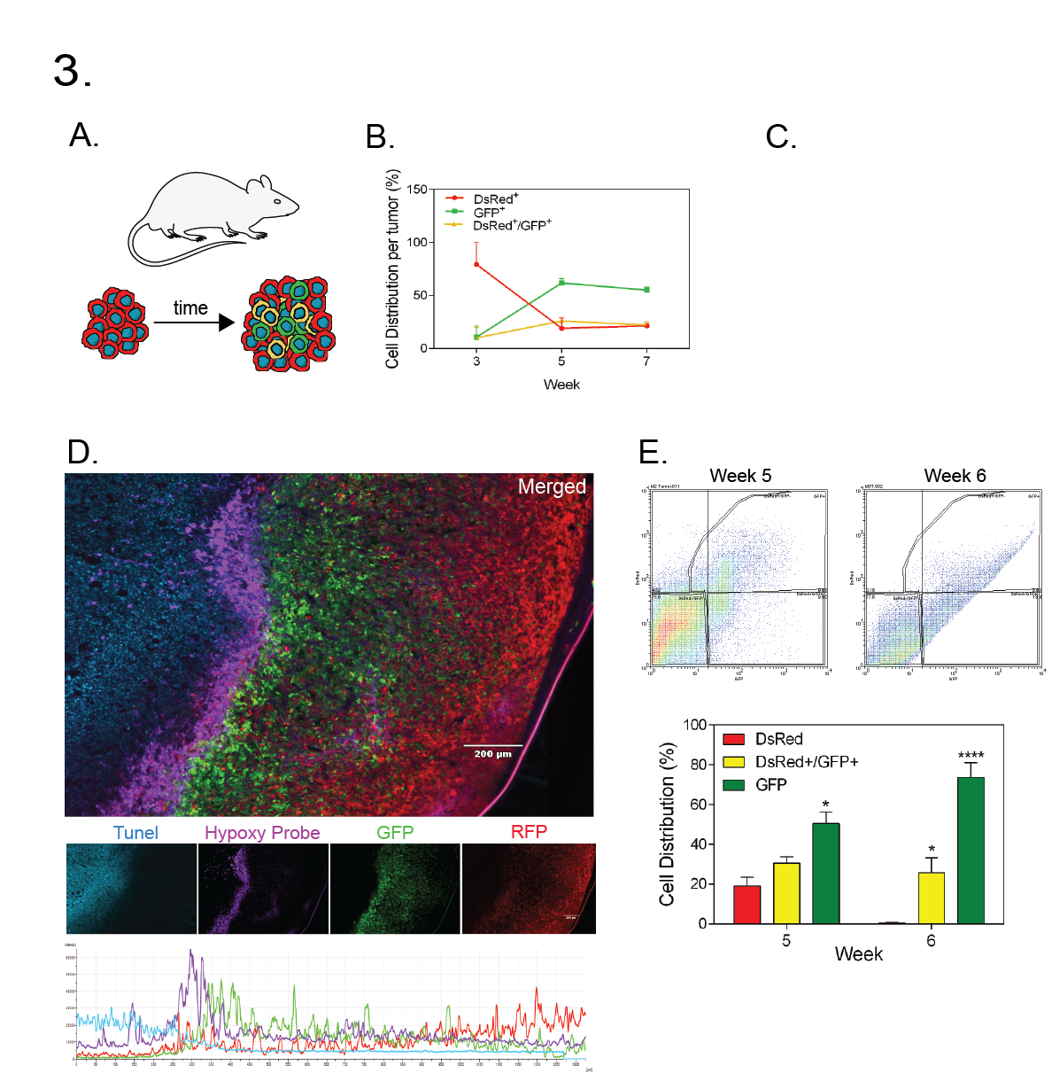
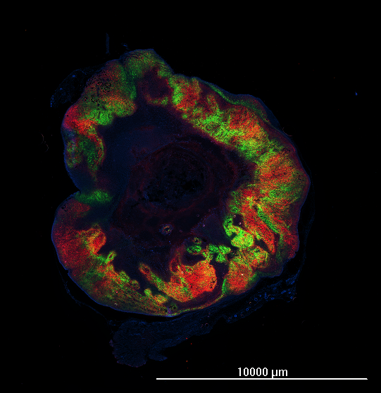
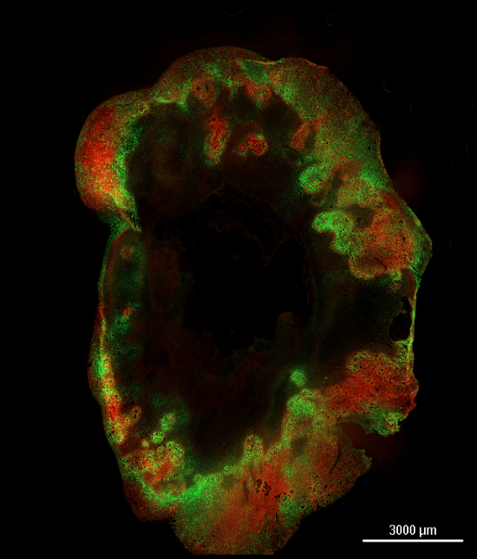
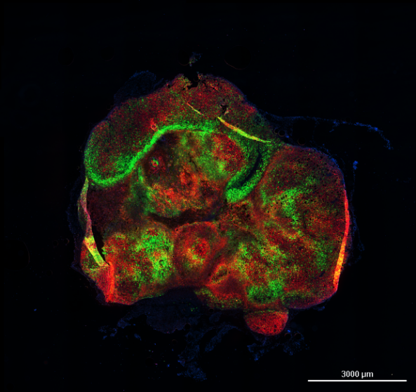
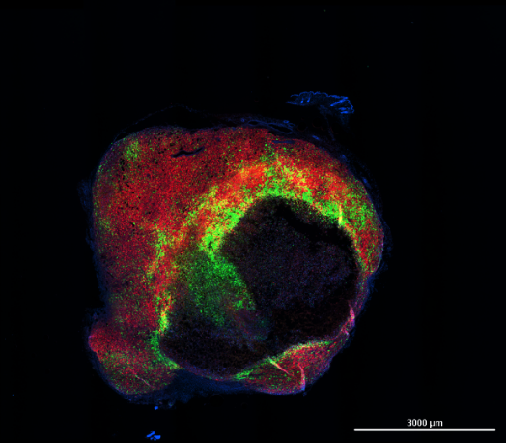
Tumor progression
Day 40
Day 35
Day 20
Day 15
1 cm

Slide 5
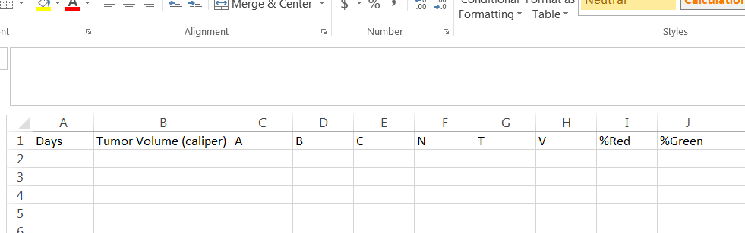
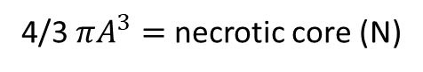
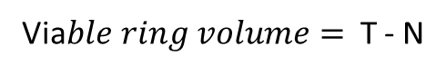
Image Processing
A + 2B = C
B
A
A = necrotic
C
B = viable
C = tumor diameter
4/3 $πA^{3}=$necrotic core (N)
4/3 $πC^{3}=$tumor volume (T) => compare to caliper measurement
Via$ble ring volume=$ T - N

Slide 6
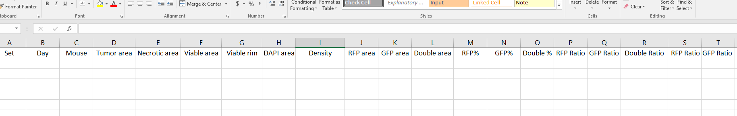
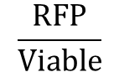
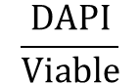
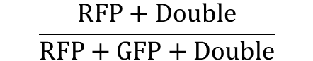
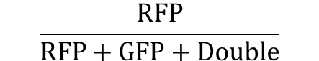
Image Processing
$$\frac{DAPI}{Viable}$$
$$\frac{RFP}{Viable}$$
$$\frac{RFP}{RFP+GFP+Double}$$
$$\frac{RFP+Double}{RFP+GFP+Double}$$

Slide 7

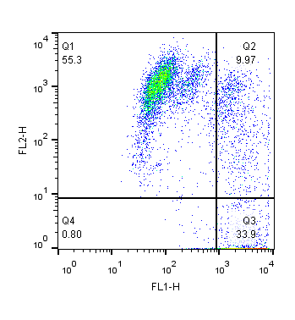

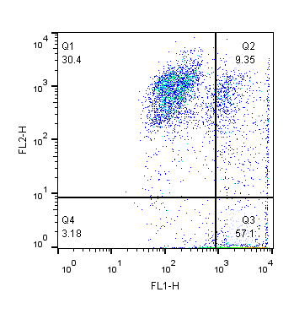
Flow cytometry
Day 35
Day 40
Day 20
Imaging
Day 15
1 cm
Day 21
Day 40
Day 42
Flow Cytometry

Slide 8
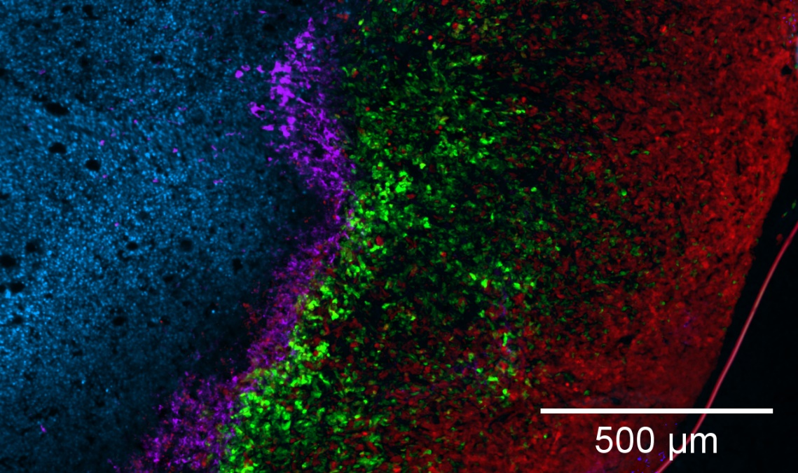
Oxygen measurement

Slide 9
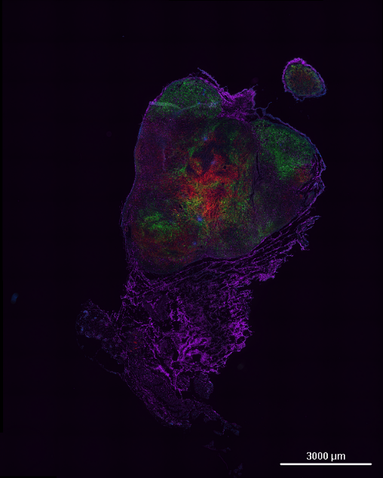
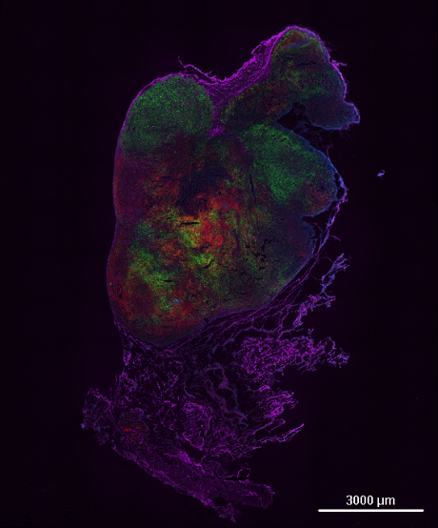
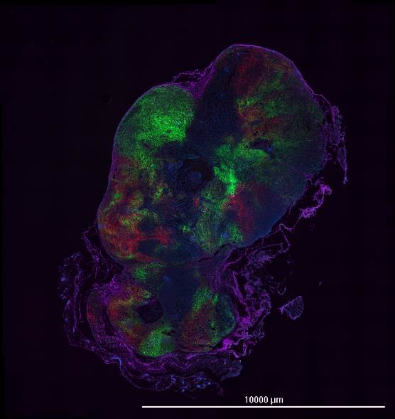
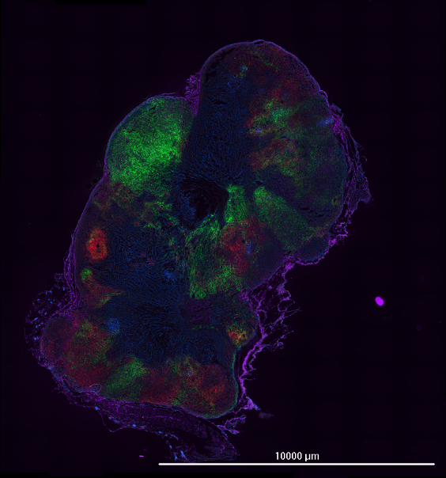
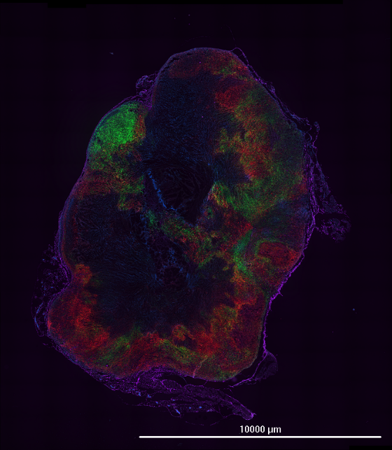
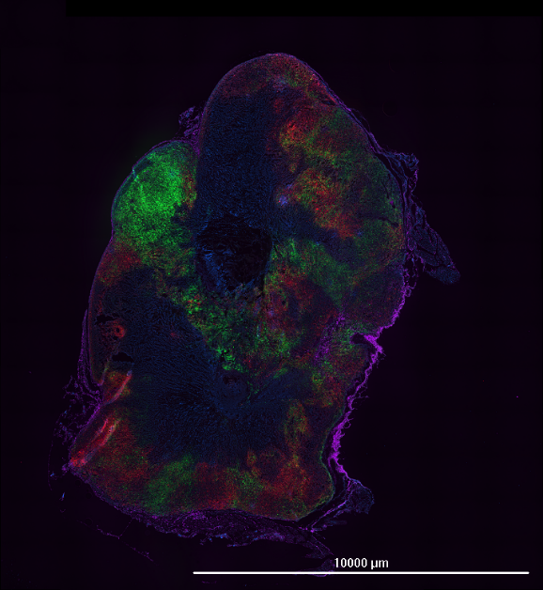
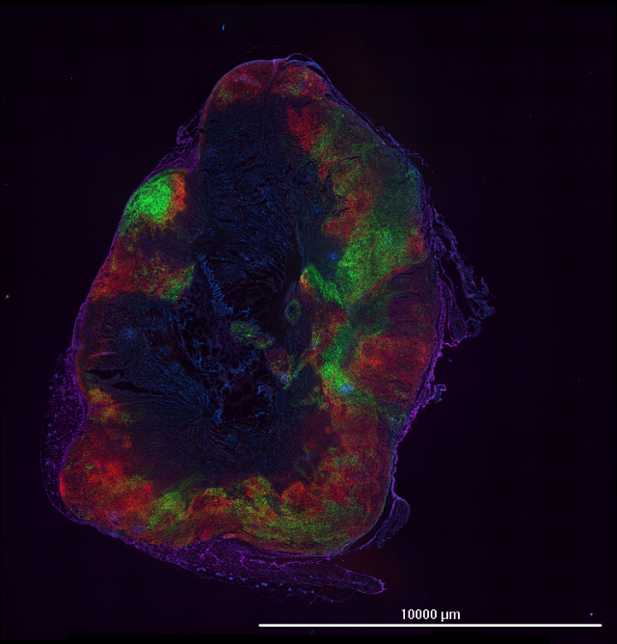
Z direction
1
2
3
4
5
6
7

Slide 10
Cell counting
# Cells (Live + Dead) by actual count = Volume of Tumor
Recent data
1 tumor approx. 20 mm³
- 0.5 million viable cells
- 1.5 dead cells
5 tumors approx. 20-30 mm³ → 100-150 mm³
- 6 million viable cells
- 25 dead cells
Also can extrapolate # cells on tissue slide by volume measurements?
Does this change with time?
25% viable
1 M cells / 10 mm³
1 M cells / 10 mm³
20% viable

Slide 11
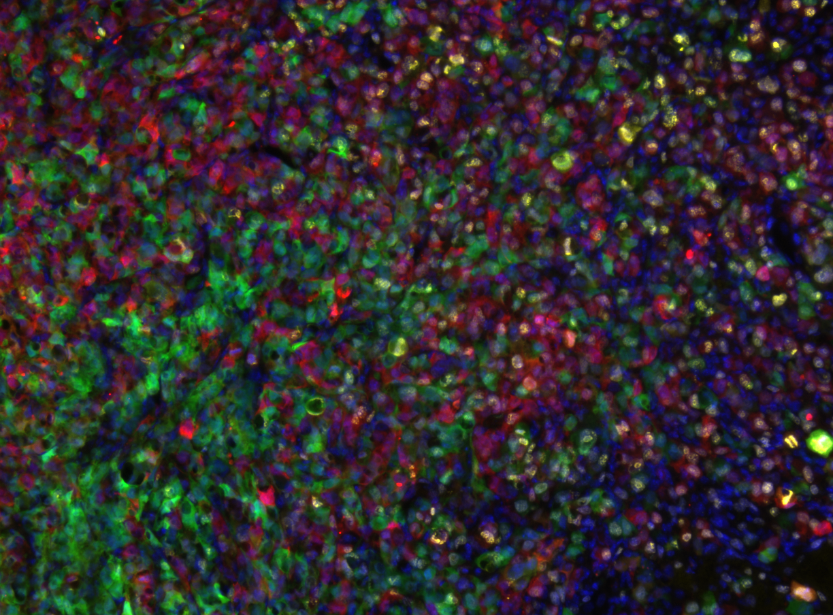
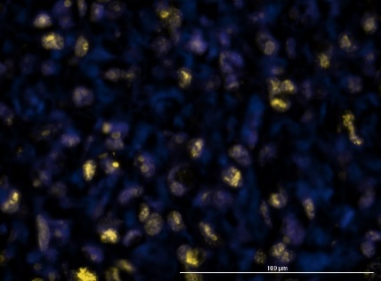

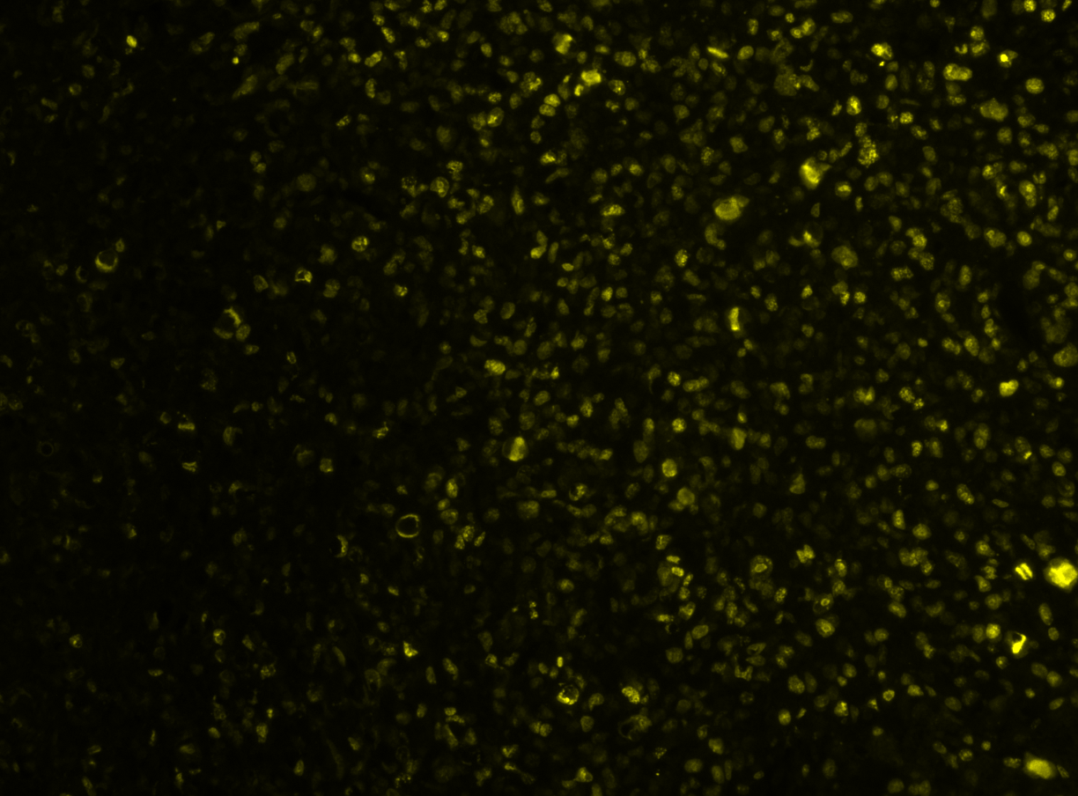
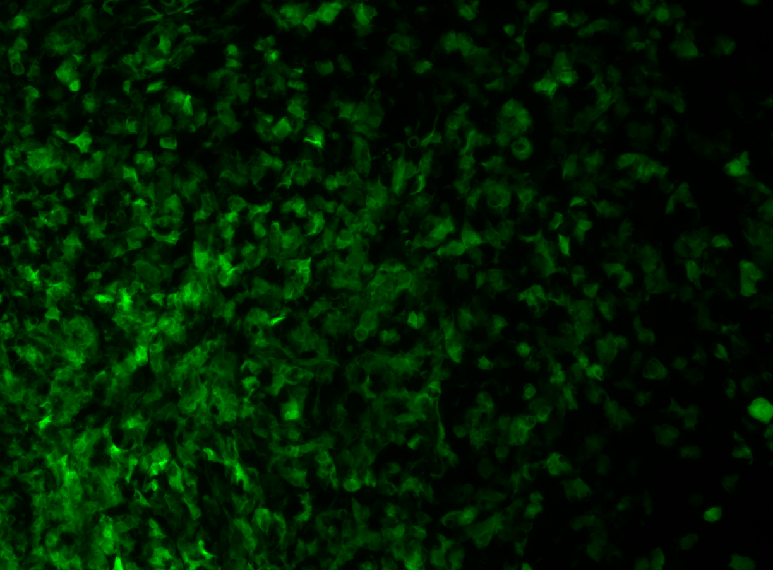
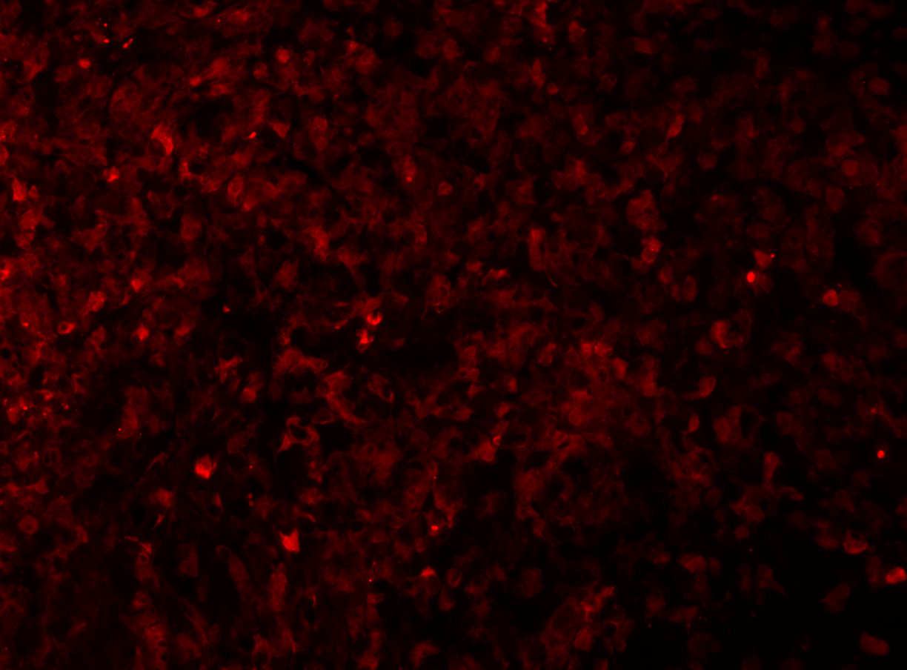
Proliferation: Ki67 staining
Merge
Merge
DAPI+Ki67 @ 40X
DAPI
Ki67
GFP
DsRed

Slide 12
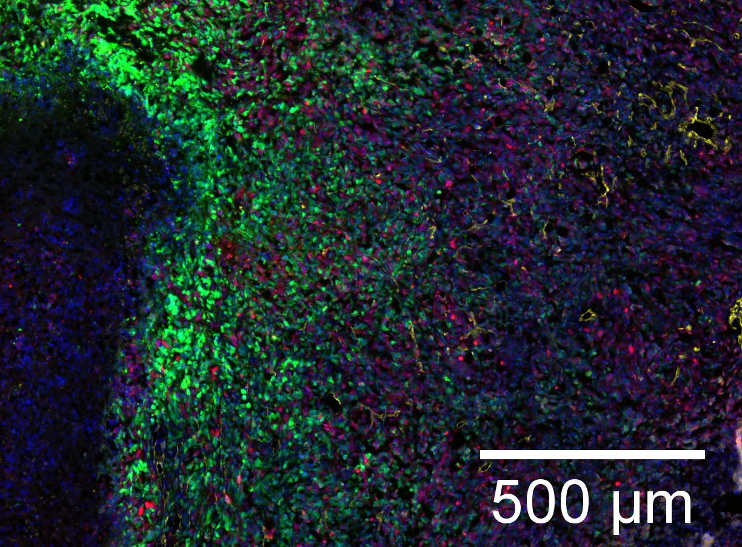
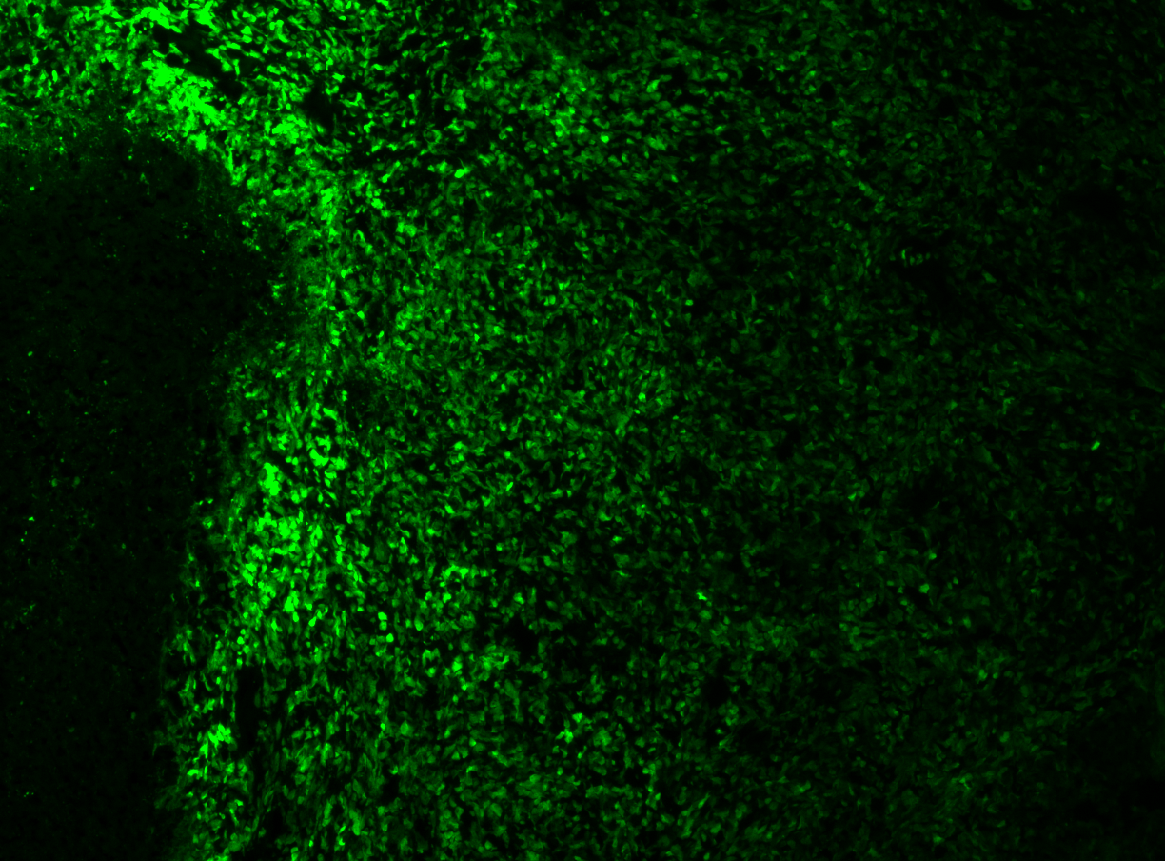
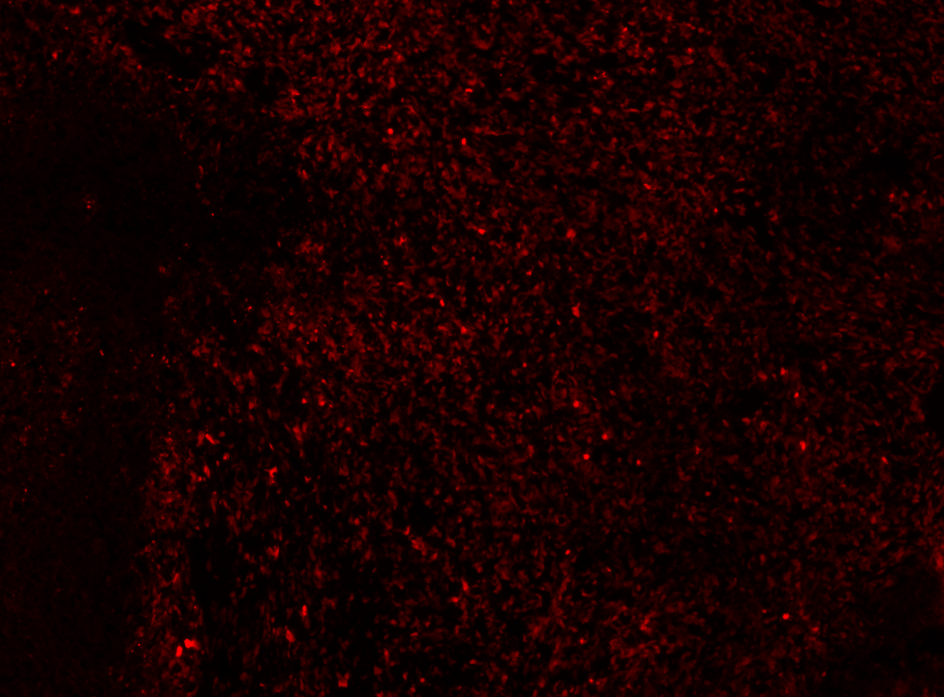
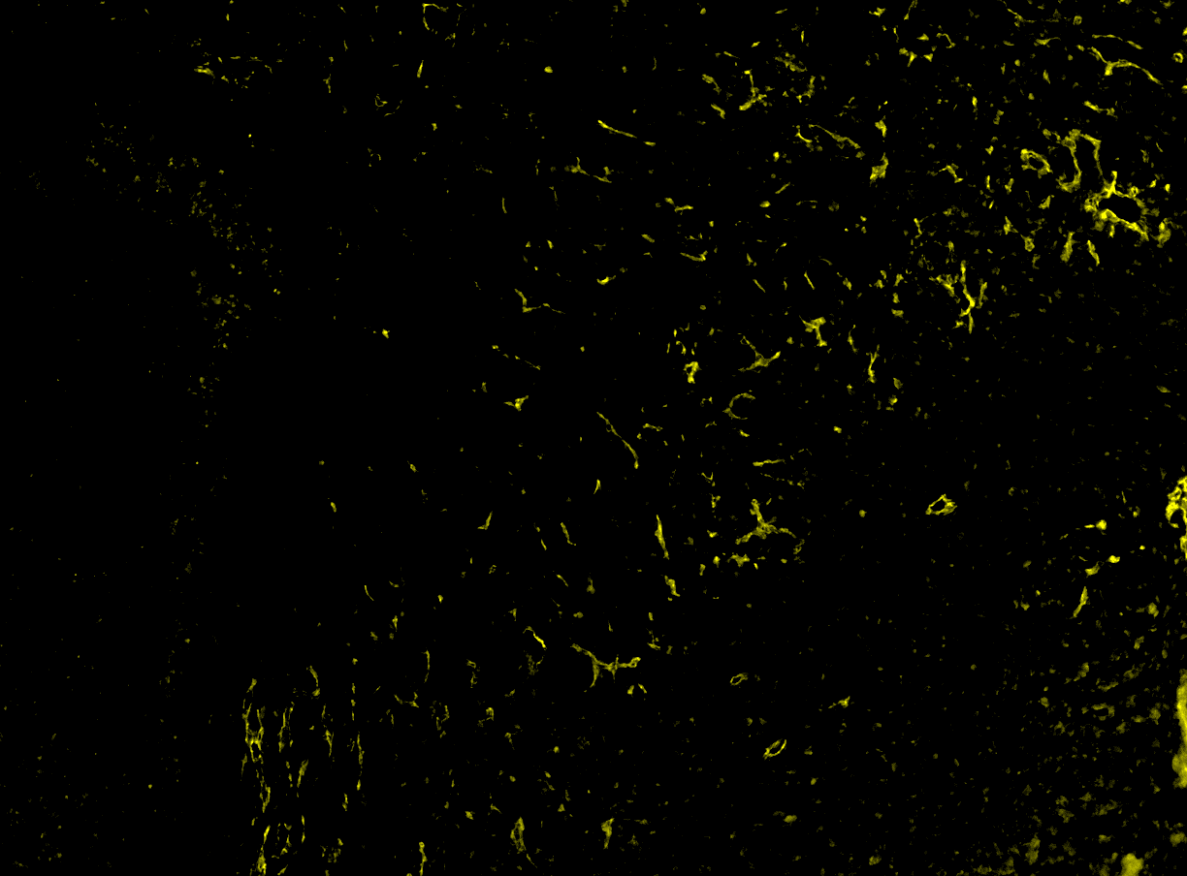
Vasculature: CD31 vs Dextran
Dextran-680
GFP
Merge
DsRed
CD31

Slide 13
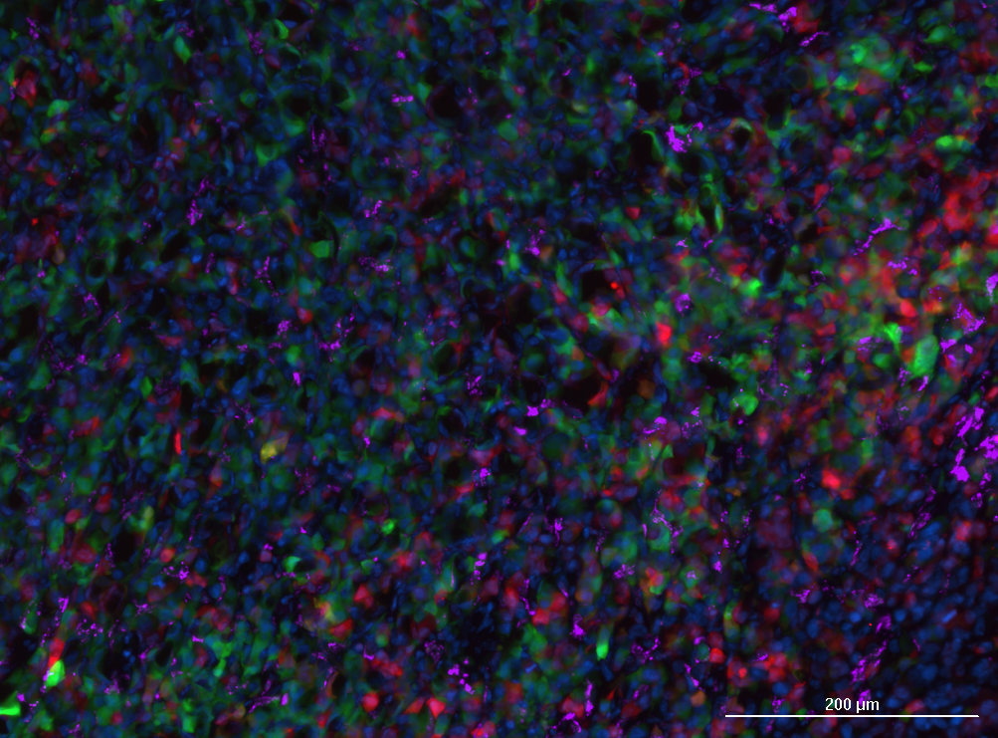
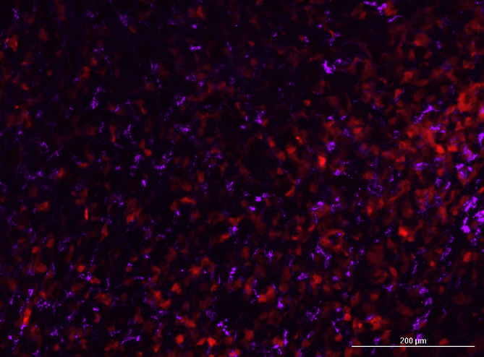
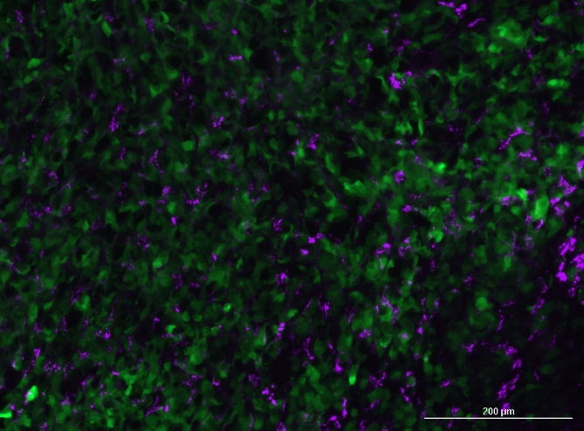

Vasculature: CD31 vs Dextran
Dextran-680
Functional vasculature
$\frac{Dextran}{Cd31}$

Slide 14
Questions
Q1: Is ratio of ki67 consistent with time?
Q2: Does ki67 changes spatially?
Q3: Does the viable rim diameter change as the tumor grows?
Q4: How should we analyze blood vessels (#/size, %area/area)? Does this change with size or spatial localization?
Q5:

Slide 15
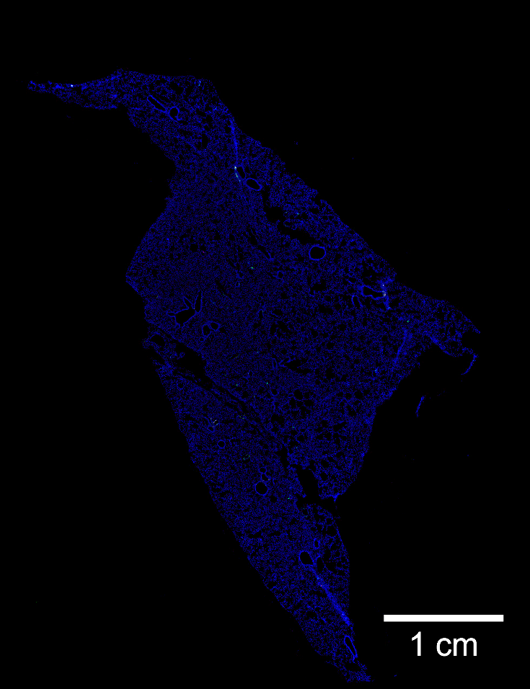
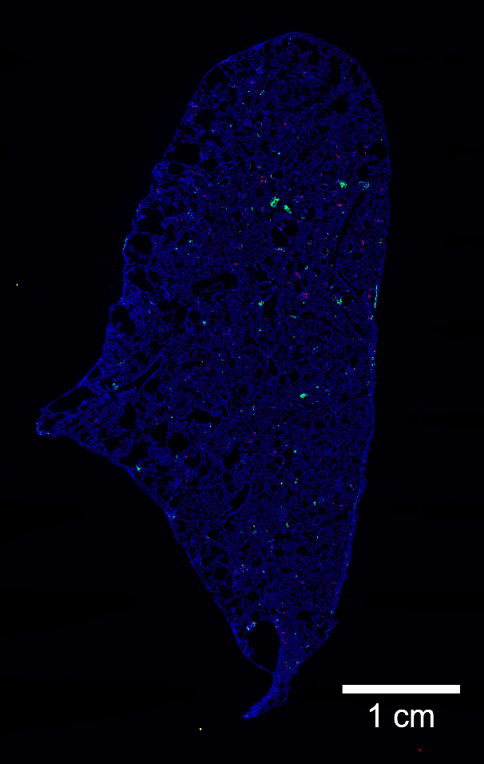
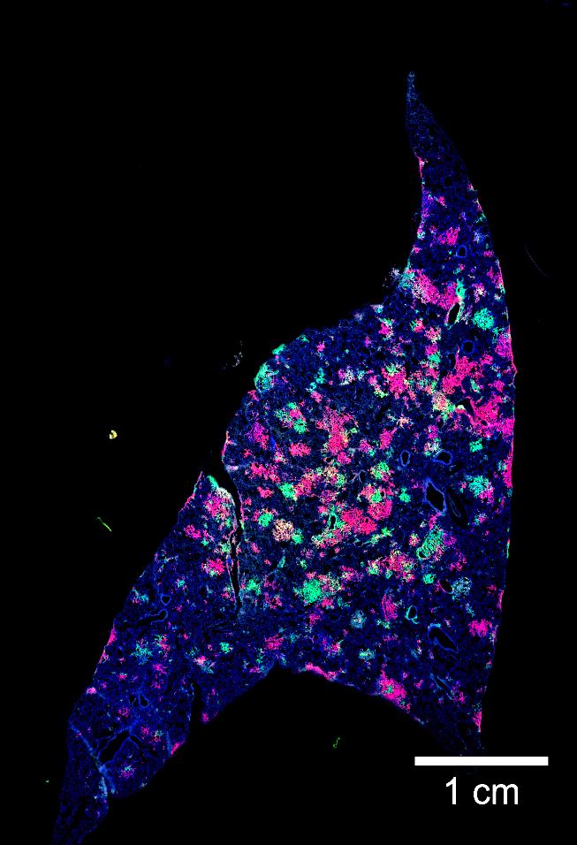
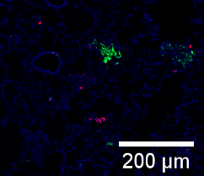
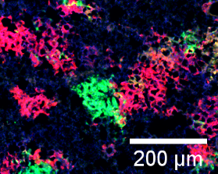
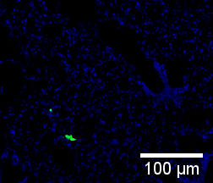
Lung metastasis
Early
Mid
Late

